Slide 1
Natural language processing
Lecture 4 – deep learning for modeling
Notes:
you have already learnt about traditional NLP methods for
such tasks as a language modeling or part of speech tagging or named-entity recognition.
So in this lesson,
we are going to cover the same tasks but with neural networks.
So neural networks is a very strong technique,
and they give state of the art performance now for these kind of tasks

Slide 2
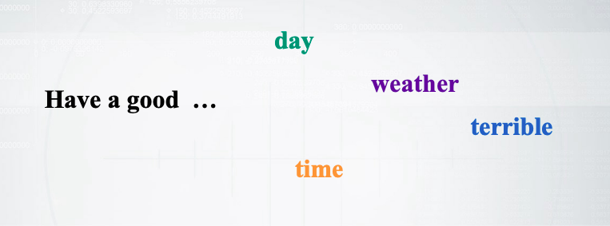

Recap: language modeling
4-gram language model:
$p\left(day | have a good\right)=\frac{c(have a good day)}{c(have a good)}$
Notes:
This is just the recap of what we have for language modeling.
So the task is to predict next words,
given some previous words,
and we know that, for example,
with 4-gram language model,
we can do this just by counting the n-grams and normalizing them

Slide 3
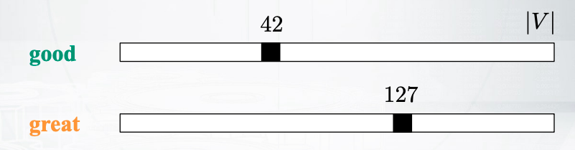
Curse of dimensionality
Imagine you have seen the following many times:
Have a good day.
However, you have not seen the following:
Have a great day.
What happens than (even with smoothing)?
Notes:
Now, let us take a closer look and let us discuss a very important problem here.
Imagine that you have some data,
and you have some similar words in this data like good and great here.
In our current model,
we treat these words just as separate items.
So for us, they are just separate indices in
the vocabulary or let us say this in terms of neural language models.
You have one-hot encoding,
which means that you encode your words with a long,
long vector of the vocabulary size,
and you have zeros in this vector and just one non-zero element,
which corresponds to the index of the words.
So this encoding is not very nice.
Why? Imagine that you see "have a good day" a lot of times in your data,
but you have never seen "have a great day".
So if you could understand that good and great are similar,
you could probably estimate some very good probabilities
for "have a great day" even though you have never seen this.
Just by saying okay,
maybe "have a great day" behaves
exactly the same way as "have a good day" because they're similar,
but if it reads the words independently,
you cannot do this.
I want you to realize that it is really
a huge problem because the language is really variative.
Just another example, let us say we have lots of breeds of dogs,
you can never assume that you have all this breeds of dogs in your data,
but maybe you have dog in your data.
So if you just know that they are somehow similar,
you can know how some particular types of dogs occur in data just
by transferring your knowledge from dogs.
Great.
What can we do about it?

Slide 4
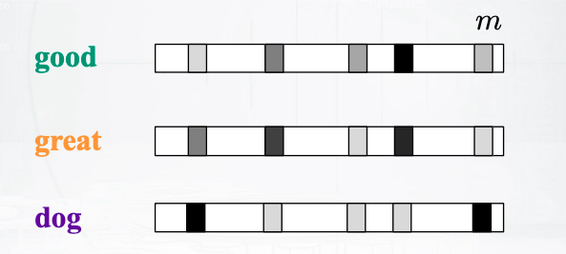

How to generalize better
Learn distributed representations for words
Express probabilities of sequences in terms of these distributed representations and learn parameters
$C^{|V|Xm}−$matrix of distributed word representations.
Notes:
Well, this is called distributed representations,
and this is exactly about fixing this problem.
So now, we are going to represent our words with their low-dimensional vectors.
So that dimension will be m,
something like 300 or maybe 1000 at most,
and this vectors will be dense.
And we are going to learn this vectors.
Importantly, we will hope that similar words will have similar vectors.
For example, good and great will be similar,
and dog will be not similar to them.
I ask you to remember this notation in the bottom of the slide,
so the C matrix will be built by this vector representations,
and each row will correspond to some words.
So we are going to define probabilistic model of
data using these distributed representations.
And we are going to learn lots of parameters including these distributed representations.

Slide 5
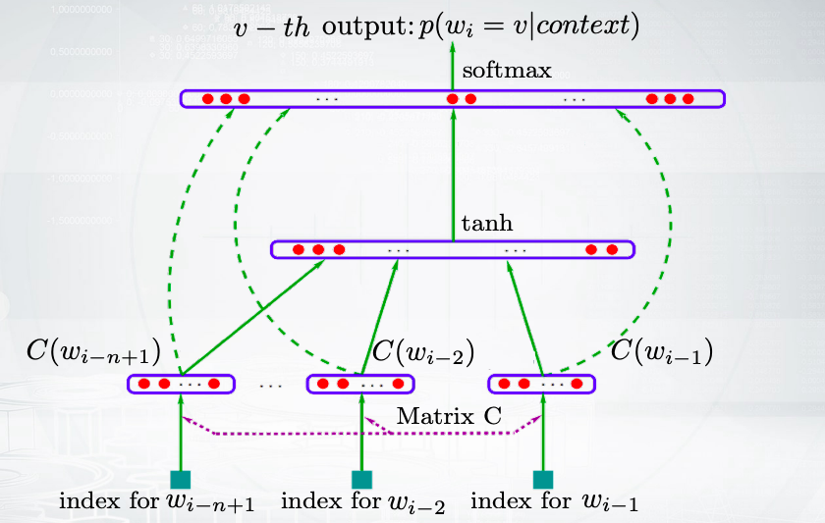
Probabilistic neural language model
Notes:
This is the model that tries to do this.
Actually, this is a very famous model from 2003 by Bengio,
and this model is one of the first neural probabilistic language models.
So this slide maybe not very understandable for yo.
That's okay. I just want you to get the idea of the big picture.
So you have your words in the bottom,
and you feed them to your neural network.
So first, you encode them with the C matrix,
then some computations occur,
and after that, you have a long y vector in the top of the slide.
So this vector has as many elements as words in the vocabulary,
and every element correspond to the probability of these certain words in your model.
Now, let us go in more details,
and let us see what are the formulas for the bottom,
the middle, and the top part of this neural network

Slide 6

Probabilistic neural language model
$p\left(w_{i} | w_{i−n+1},…,w_{i−1}\right)=\frac{exp⁡(y_{w_{i}})}{\sum_{w∈V}{exp⁡(y_{w})}}$. Softmax over components of y
$y=b+W_{x}+Utanh\left(d+Hx\right)$ Free-forward NN with tons of parameters
$x={\left[C\left(w_{i−n+1}\right),…,C(w_{i−1})\right]}^{T}$ Distributed representation of context words
Notes:
So the last thing that we do in our neural network is softmax.
We apply to the components of y vector.
The y vector is as long as the size of the vocabulary,
which means that we will get some probabilities normalized over words in the vocabulary,
and that's what we need.
What happens in the middle of our neural network?
There is some huge computations here with lots of parameters.
Actually, every letter in this line is some parameters,
either matrix or vector.
The only letter which is not parameters is x,.
So what is x?
X is the representation of our context.
You remember our C matrix,
which is just distributed representation of words.
So you take the representations of all the words in your context,
and you concatenate them, and you get x.
So just once again from bottom to the top this time.
You get your context representation.
You feed it to your neural network to compute
y and you normalize it to get probabilities.

Slide 7
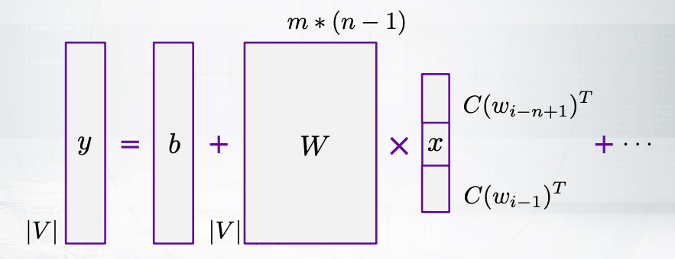

It’s over-complicated…
$y=b+W_{x}+U tanh⁡(d+H_{x})$
Notes:
and we can see that what we want to get in the result of this formula,
has the dimension of the size of the vocabulary.
Now what is the dimension of x?
Well, x is the concatenation of
m dimensional representations of n minus 1 words from the context.
So it is m multiplied by n minus 1.
Here you go. You can see the dimension of W matrix.
So this neural network is great,
but it is kind of over-complicated.
So you can see that you have some non-linearities here,
and it can be really time-consuming to compute this.

Slide 8
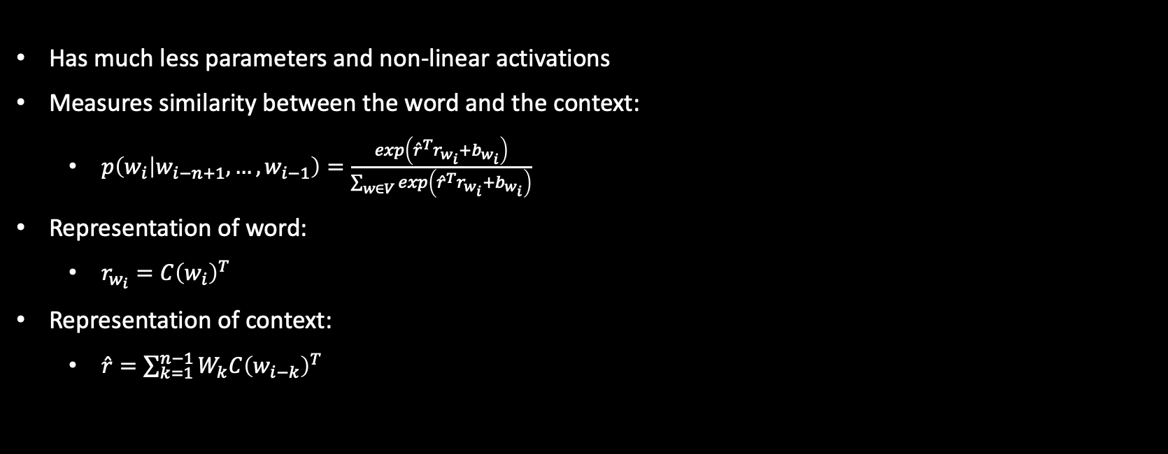
Log-Bilinear Language Model
Has much less parameters and non-linear activations
Measures similarity between the word and the context:
$p\left(w_{i} | w_{i−n+1},…,w_{i−1}\right)=\frac{exp\left({\hat{r}}^{T}r_{w_{i}}+b_{w_{i}}\right)}{\sum_{w∈V}{exp\left({\hat{r}}^{T}r_{w_{i}}+b_{w_{i}}\right)}}$
Representation of word:
$r_{w_{i}}={C\left(w_{i}\right)}^{T}$
Representation of context:
$\hat{r}=\sum_{k=1}^{n−1}{W_{k}C{\left(w_{i−k}\right)}^{T}}$
Notes:
So the next slide is about a model which is simpler.
Let's try to understand this one.
It is called log-bilinear language model.
Maybe it doesn't look like something more simpler but it is.
So let us figure out what happens here.
You still have some softmax,
so you still produce some probabilities,
but you have some other values to normalize.
So you have some bias term b,
which is not important now.
The important part is the multiplication
of word representation and context representation.
Let's figure out what are they.
So the word representation is easy.
It's just the row of your C matrix.
What is the context representation?
You still get your rows of the C matrix to represent individual words in the context,
but then you multiply them by Wk matrices,
and this matrices are different for different positions in the context.
So it's actually a nice model.
It is not a bag-of-words model.
It tries to capture somehow that words that just go before your target words can
influence the probability in some other way than
those words that are somewhere far away in the history.
So you get your word representation and context representation.
And then you just have dot product of them to compute the similarity,
and you normalize this similarity.
So the model is very intuitive.
It predicts those words that are similar to the context.

Slide 9
Whether you need to predict a next word or label
Lstms are here to help

Slide 10
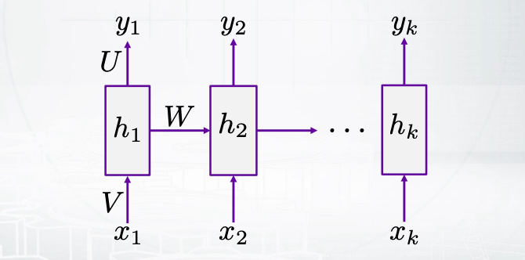

Recap: recurrent neural networks
Extremely popular architecture for any sequential data:
$h_{i}=f\left(Wh_{i−1}+V_{x_{i}}+b\right)$
$y_{i}=Uh_{i}+\tilde{b}$
Notes:
this is a technique that helps you to model sequences.
You have an input sequence of x and you have an output sequence of y.
Importantly, you have also some hidden states which is h.
So here you can know how you transit from one hidden layer to the next one.
So this is just some activation function f applied to
a linear combination of the previous hidden state and the current input.
Now, how do you output something from your network?
Well, this is just a linear layer applied to your hidden state.
So, you just multiply your hidden layer by U metrics,
which transforms your hidden state to your output y vector.
how can we apply this network for language bundling?

Slide 11
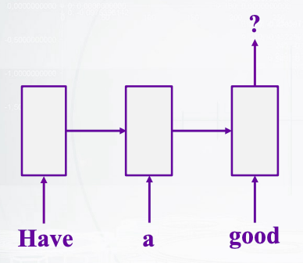
RNN language model
Predicts a next word based on a previous context
Architecture:
Use the current state output
Apply a linear layer on top
Do softmax to get probabilities.
Notes:
actually straightforwardly.
So the input is just some part of our sequence and
we need to output the next part of this sequence.
What is the dimension of those U metrics from the previous slide?
we need to get the probabilities of different watts in our vocabulary.
So the dimension will be the size of hidden layer by
the size our output vocabulary.
Okay, so we apply softmax and we get our probabilities.
Okay, how do we train this model?

Slide 12
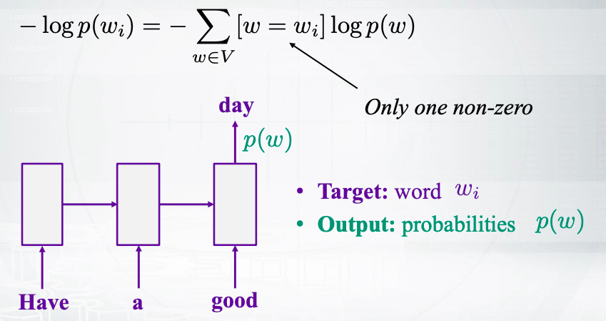
How do we train it?
Cross-entropy loss (form one position):
Notes:
how do we train this model?
So in the picture you can see that actually we know the target word,
this is day, and this is wi for us in the formulas.
What does the model, the model outputs the probabilities of any word for
this position?
So, we need somehow to compare our work,
probability distribution and our target distribution.
So, the target distribution is just one for day and
zeros for all the other words in the vocabulary.
And we compare this to distributions by cross-entropy loss.
You can see that we have a sum there over all words in the vocabulary, but
this sum is actually a fake sum because you have only one non-zero term there.
And this non-zero term corresponds to the day, to the target word, and
you have the probable logarithm for the probability of this word there.
Okay, so the cross-center is probably one of the most commonly used losses ever for
classification.
So maybe you have seen it for the case of two classes.
Usually there you have just labels like zero and ones, and
you have the label multiplied by some logarithm plus one minus label
multiplied by some other logarithms.
Here, this is just the general case for many classes.
Okay, so, we get some understanding how we can train our model.
Now, how can we generate text?
How can we use our model once it's trained?

Slide 13
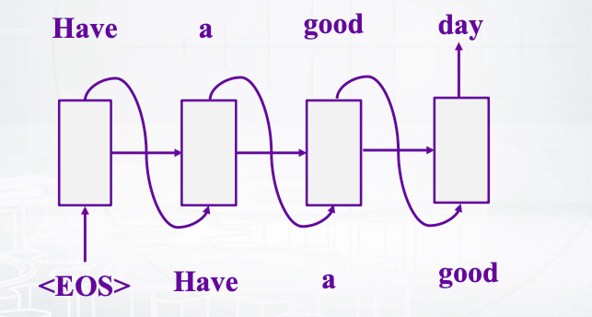
How do we use it to generate language?
Idea
Feed the previous output as the next input
Take argmax at each step (greedily) or use beam search
Notes:
We need some ideas here.
So the idea is that, let's start with just fake talking,
with end of sentence talking.
And let's try to predict some words.
So we get our probability distribution.
How do we get one word out of it?
Well we can take argmax.
This is the easiest way.
So let's stick to it for now.
Now what can we do next?
Next, and this is important.
We can feed this output words as an input for the next state like that.
And we can produce the next word by our network.
So we continue like this we produce next and
next words, and we get some output sequence.
Now we took argmax every time.
So it was kind of a greedy approach, why?
Because when you will see your sequence, have a good day, you generated it.
Well probably it's not the sequence with the highest probability.
Because you could, maybe at some step, take some other word,
but then you would get a reward during the next step because you would get a high
probability for some other output given your previous words.
So something that can be better than greedy search here is called beam search.
So beam search doesn't try to estimate the probabilities of all possible sequences,
because it's just not possible, they are too many of them.
But beam search tries to keep in mind several sequences, so at
every step you'll have, for example five base sequences with highest possibilities.
And you try to continue them in different ways.
You continue them in different ways, you compare the probabilities, and
you stick to five best sequences, after this moment again.
And you go on like this, always keeping five best sequences and
you can result in a sequence which is better than just greedy argmax approach

Slide 14
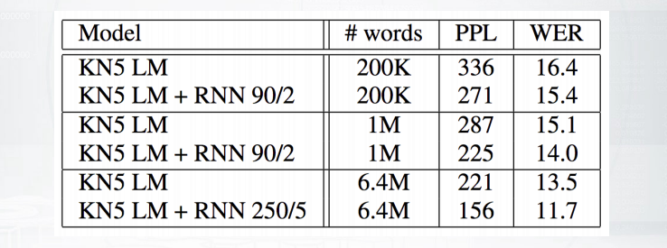
Rnn language model
RMM-LM has lower perplexity and word error rate than 5-gram model with Knesser-Ney smoothing.
The experiment is held on Wall Street Journal corpus:
Later experiments: char-level RNNs can be very effective!
Notes:
I want to show you the experiment that was held and this is the experiment
that compares recurrent network model with Knesser-Ney smoothing language model.
So you remember Knesser-Ney smoothing from our first videos.
And here this is 5-gram language model.
You can see that when we add recurrent neural network here
we get improvement in perplexity and in word error rate.
So this is nice.
This says that recurrent neural networks can be very helpful for language modeling.
And one interesting thing is that, actually we can apply them,
not only to word level, but even to characters level.
So instead of producing the probability of the next word, giving five previous words,
we would produce the probability of the next character,
given five previous characters

Slide 15
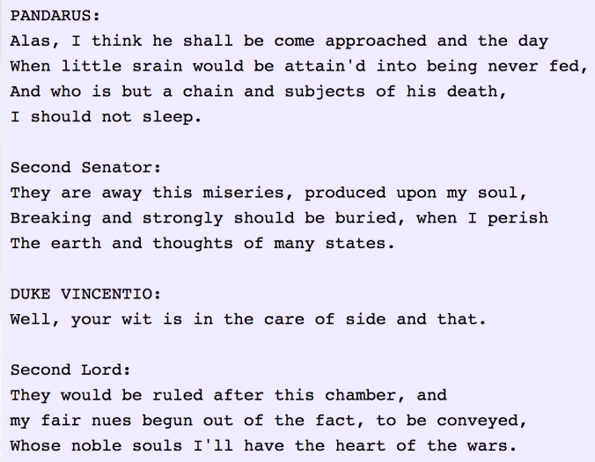
Character-level rnn: Shakespeare example
Notes:
And this is how this model works.
So this is the Shakespeare corpus that you have already seen.
And you can see that this character-level recurrent neural network
can remember some structure of the text.
So you have some turns, multiple turns in the dialog, and this is awesome I think.

Slide 16
Cook your own language model
Use LSTMs or GRUs, and gradient clipping
https://colah.github.io/posts/2015-08-Understanding-LSTMs/
Start with one layer, then stack 3-4, use skip connections
Use dropout for regularization:
Zaremba, Sutskever, Vinyals, Recurrent Neural Network Regularization, 2014.
Have a look into TF tutorial for a working model:
https://www.tensorflow.org/tutorials/recurrent
Tune learning rate schedule in SGD or use Adam
Explore state-of-the-art improvements:
July 2017: on the state of the art of evaluation in neural language models.
August 2017: regularizing and optimizing LSTM language models
Notes:
Okay, so this is just vanilla recurring neural network, but
in practice, maybe you want to do something more.
You want some other tips and tricks to make your awesome language model work.
So first thing to remember is that probably you want to use
long short term memory networks and use gradient clipping.
Why is it important?
Well you might know about the problem of exploding gradients or gradients.
And this architectures can help you to deal with this problems.
If you do not remember LSTM model,
you can check out this blog post which is a great explanation of LSTM.
You can start with just one layer LSTM, but
maybe then you want to stack several layers like three or four layers.
And maybe you need some residual connections that allow you to skip
the layers.
Now another important thing to keep in mind is regularization.
You could hear about drop out.

Slide 17
Sequence tagging tasks
Part-of-speech tagging
Named entity recognition
Semantic role labelling
…
BIO-notation
B-beginning, I-inside, O-outside
B_ACT I I_ACT O B_NUM_PER. O B_LOC I_LOC
Book. a table. For 3. in. Domino’s pizza
Notes:
This example will be about sequence tagging task.
So you have heard about part of speech tagging and named entity recognition.
And this is one more task which is called symmetrical labelling.
Imagine you have some sequence like, book a table for three in Domino's pizza.
Now, you want to find some symantic slots like book a table is an action,
and three is a number of persons, and Domino's pizza is the location.
Usually use B-I-O notation here which says that we have
some beginning of the slowed sound inside the slot and
just outside talkings that do not belong to any slot at all, like for and in here

Slide 18
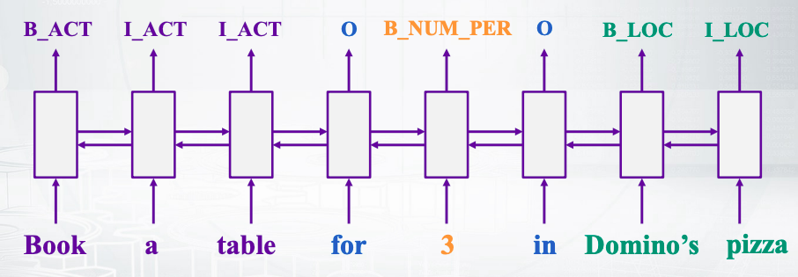
Bi0directional lstm
Universal approach for sequence tagging
You can stack several layers + add linear layers on top
Trained by cross-entropy loss coming from each position
Notes:
show you that my directional is LSTM as super helpful for this task.
So, what is a bi-directional LSTM?
Well you can imagine just LSTM that goes from left to the right, and
then another LSTM that goes from right to the left.
Then you stack them, so you just concatenate the layers,
the hidden layers, and you get your layer of the bi-directional LSTM.
After that, you can apply one or more linear layers on top and
get your predictions.
And you train this model with cross-entropy as usual.
So nothing magical.

